Slide 1

J: A modern math-oriented APL
29th of January 2022
M. Liarmakopoulos
APL ∊ BCN

Slide 2
This talk
History
Live coding
Questions ???
References
Thanks

Slide 3
History
1990
Arthur Whitney http://www.jsoftware.com/jwiki/Essays/Incunabulum
Expanded Incunabulum: https://gist.github.com/mlliarm/a59bb723552e4a1ab646fd321cbc58cb
Roger & Ken
Eric
JSoftware team & Community: https://github.com/jsoftware/jsource

Slide 4
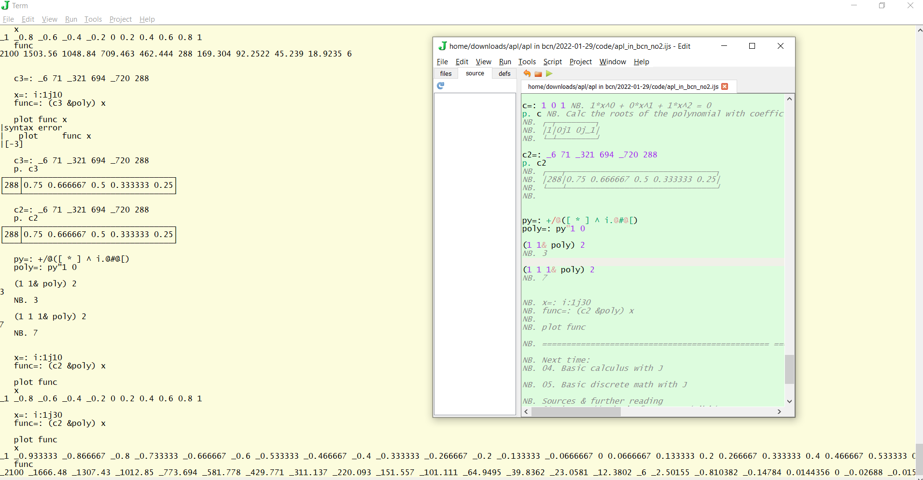
2. Live coding

Slide 5

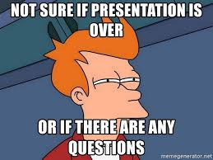

Questions ???

Slide 6
4. References
Devon McCormick’s, Minimal Beginner J
https://code.jsoftware.com/wiki/Studio/Gallery
https://code.jsoftware.com/wiki/Studio/Viewmat
https://code.jsoftware.com/wiki/Plot
https://code.jsoftware.com/wiki/Plot/Examples
https://code.jsoftware.com/wiki/Plot/Contrib
https://code.jsoftware.com/wiki/Books#Exploring_Math
JPrimer, by Eric: https://www.jsoftware.com/help/primer/contents.htm
An Implementation of J, by Roger: https://www.jsoftware.com/ioj/ioj.htm
New vocabulary: https://code.jsoftware.com/wiki/NuVoc

Slide 7
5. Thanks
All the very friendly and welcoming APLjk community.
Bob
Devon
You for joining.

